Slide 1
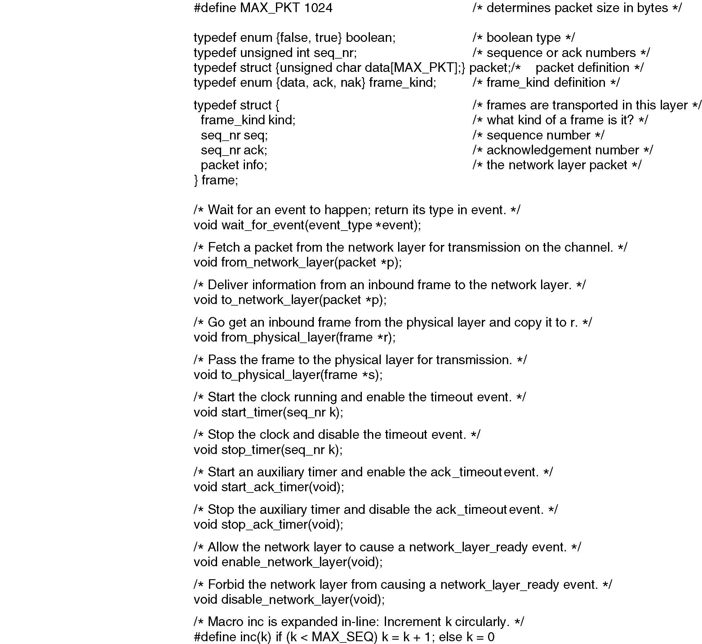
Protocol Definitions
Continued →
Some definitions needed in the protocols to follow. These are located in the file protocol.h.

Slide 2
Protocol
Definitions
(continued)
Some definitions needed in the protocols to follow. These are located in the file protocol.h.

Slide 3
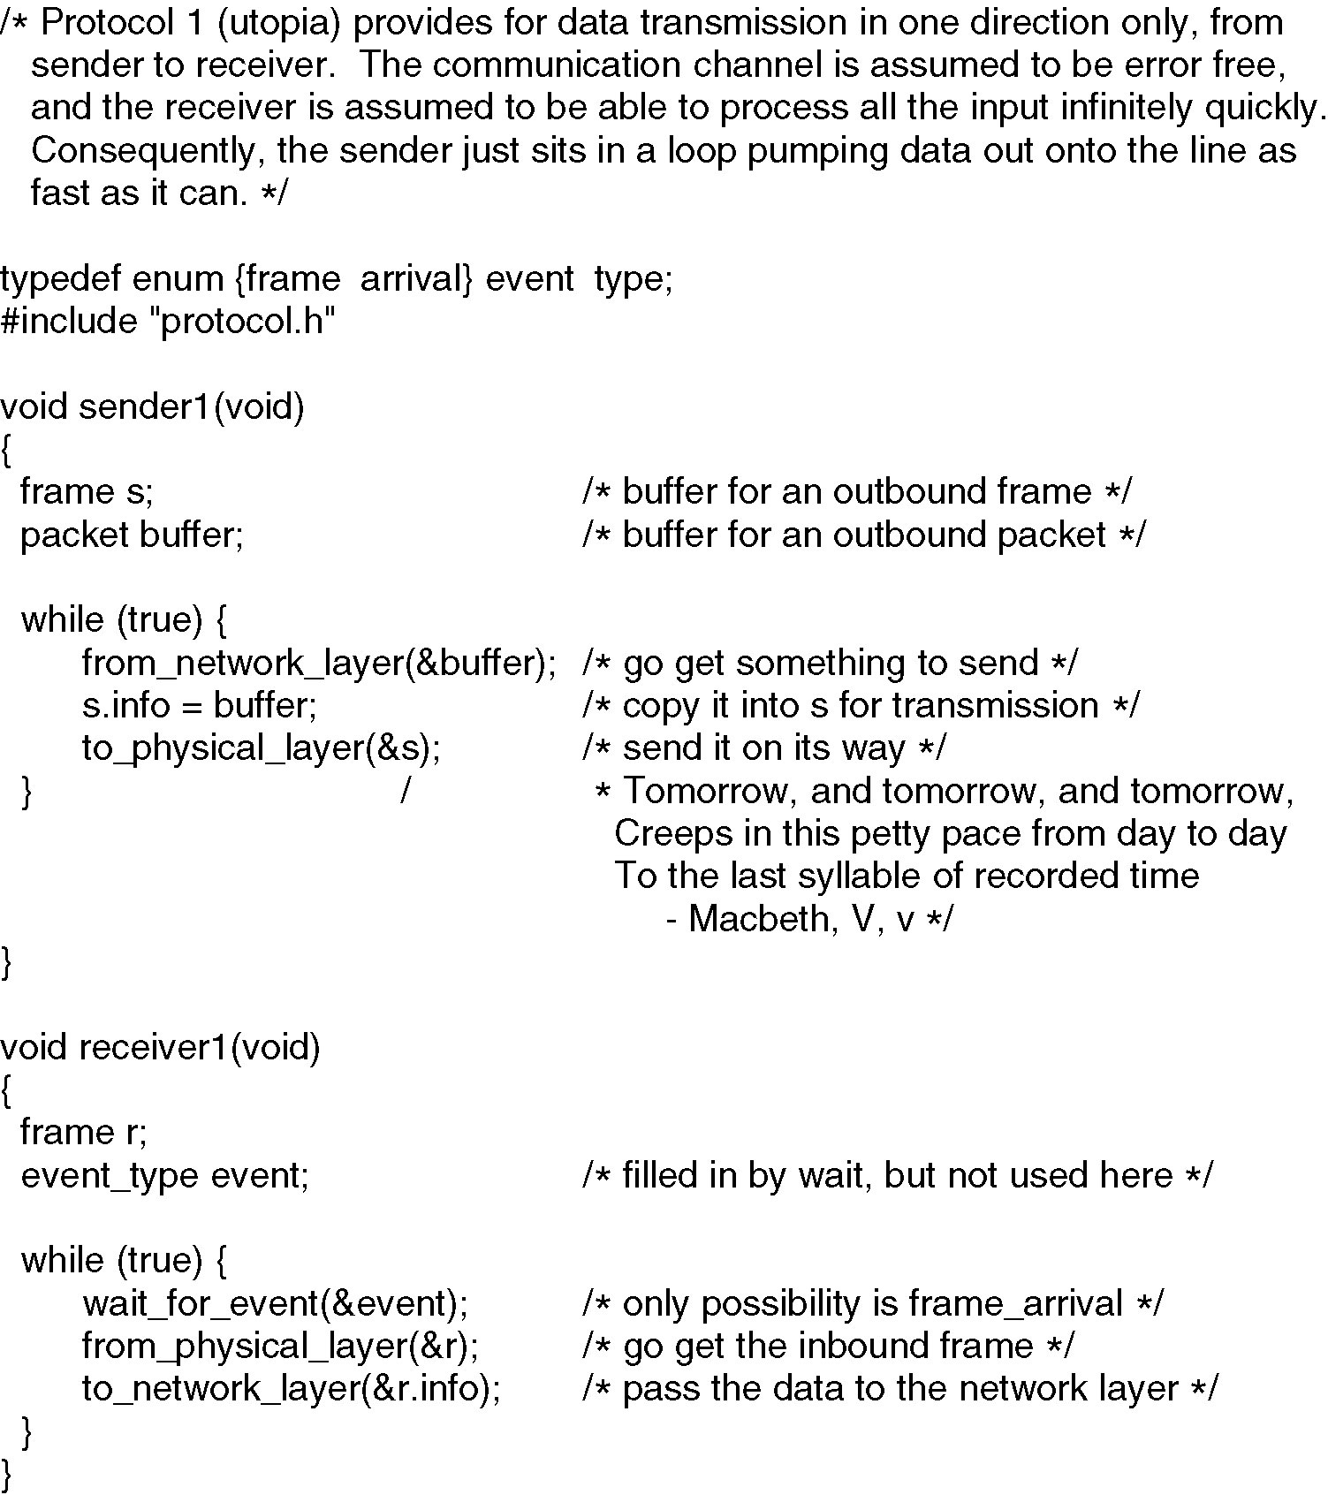
Unrestricted
Simplex
Protocol

Slide 4
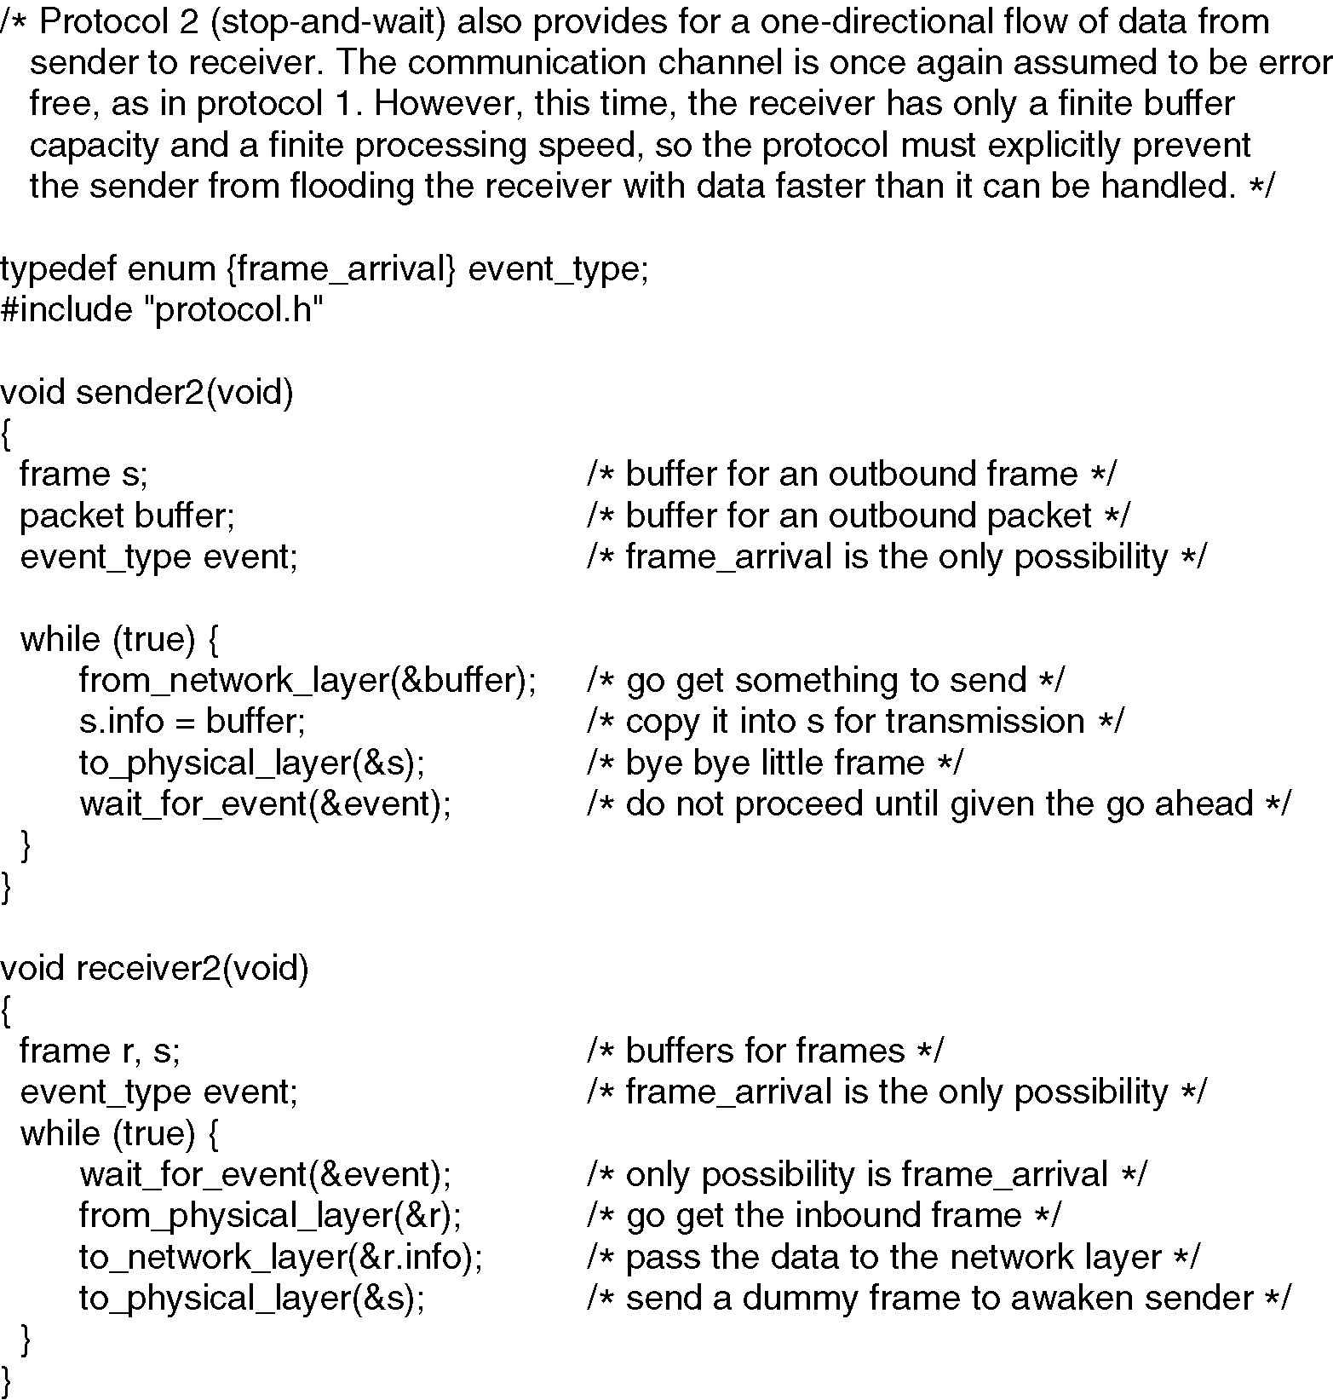
Simplex Stop-and-Wait Protocol

Slide 5
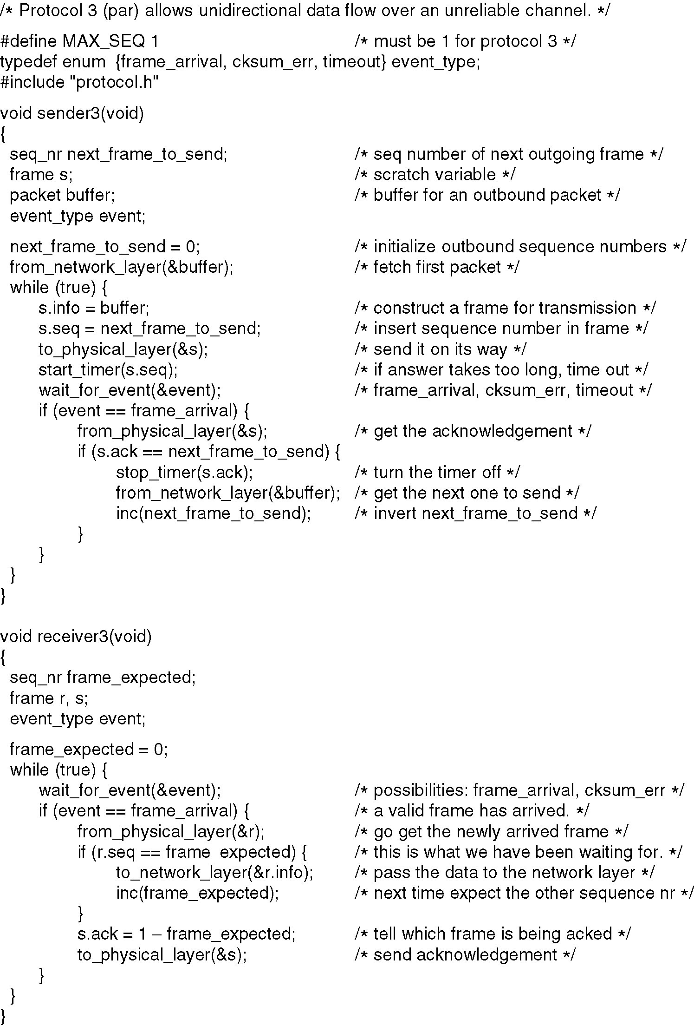
A Simplex Protocol for a Noisy Channel
A positive acknowledgement with retransmission protocol.
Continued →

Slide 6
A Simplex Protocol for a Noisy Channel (ctd)
A positive acknowledgement with retransmission protocol.

Slide 7
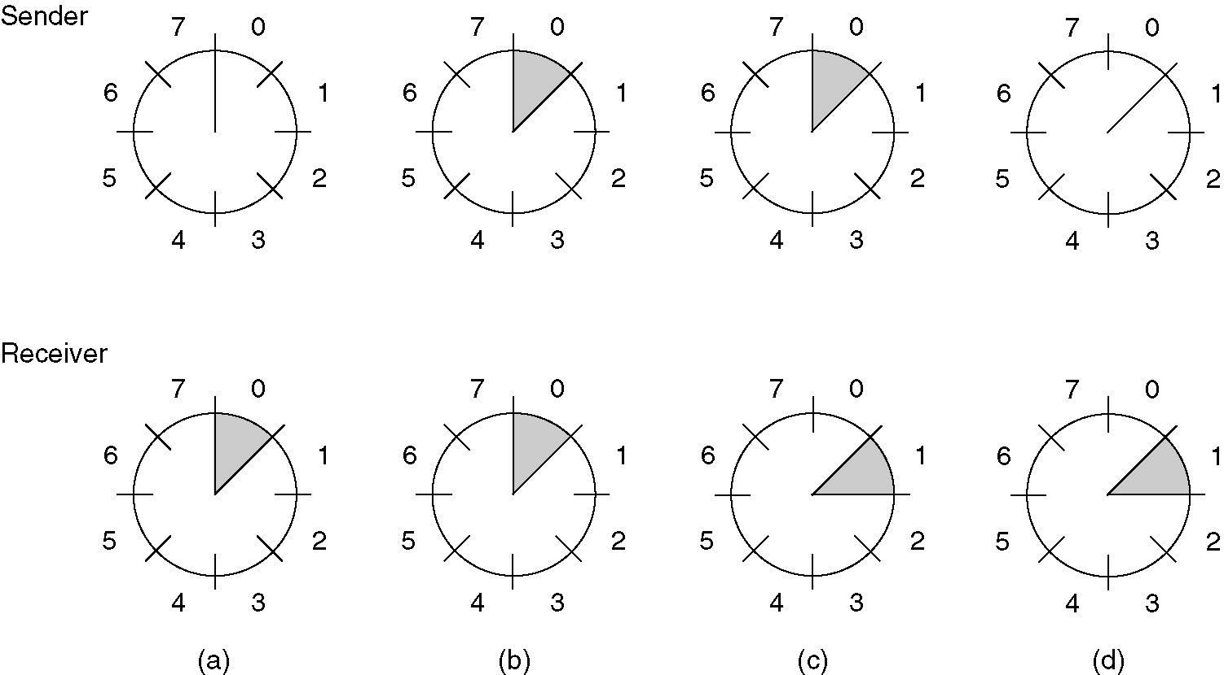
Sliding Window Protocols
A sliding window of size 1, with a 3-bit sequence number
(a) Initially
(b) After the first frame has been sent
(c) After the first frame has been received
(d) After the first acknowledgement has been received

Slide 8
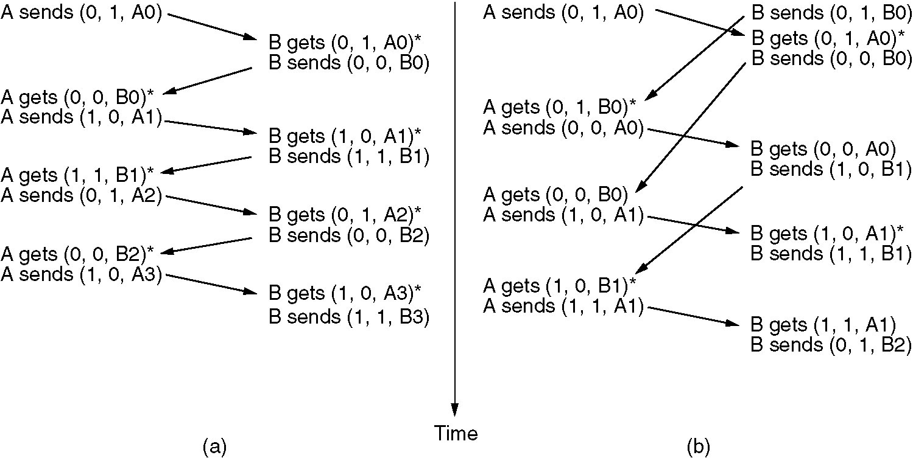
A One-Bit Sliding Window Protocol
(a) Normal case. (b) Abnormal case.
The notation is (seq, ack, packet number). An asterisk indicates where a network layer accepts a packet.

Slide 9
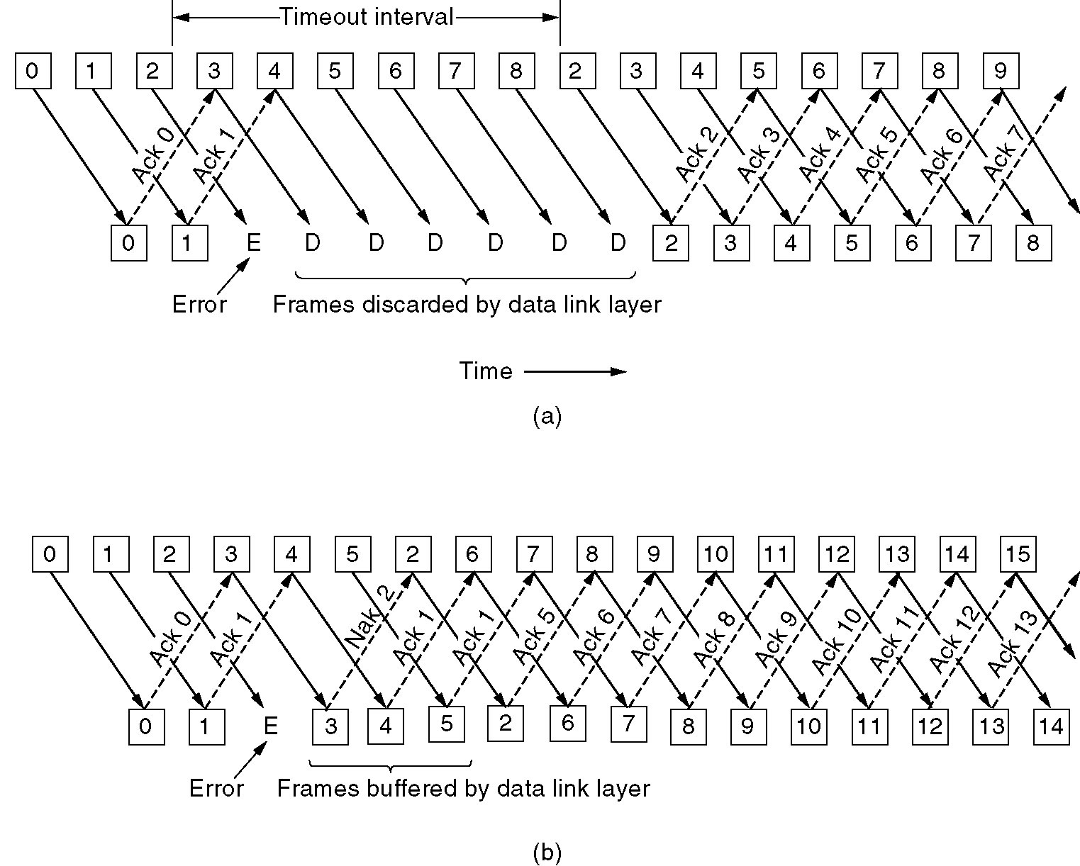
go back N Example
Effect on an error when receiver’s window size is 1

Slide 10
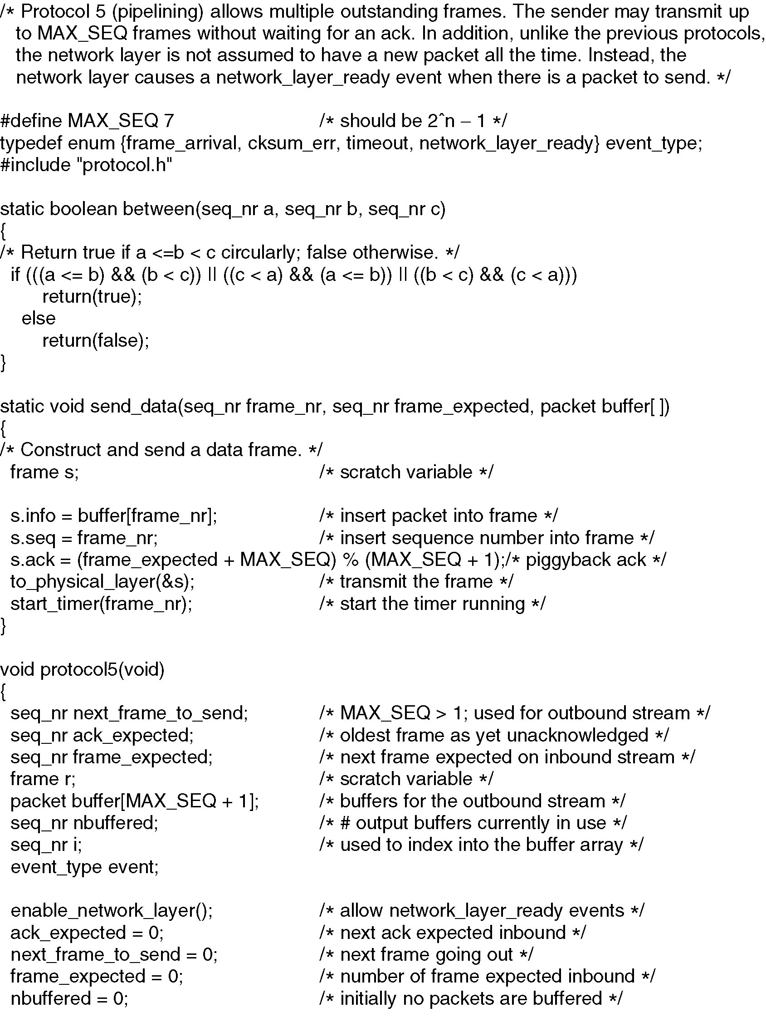
Sliding Window Protocol Using Go Back N
Continued →

Slide 11
Sliding Window Protocol Using Go Back N
Continued →

Slide 12
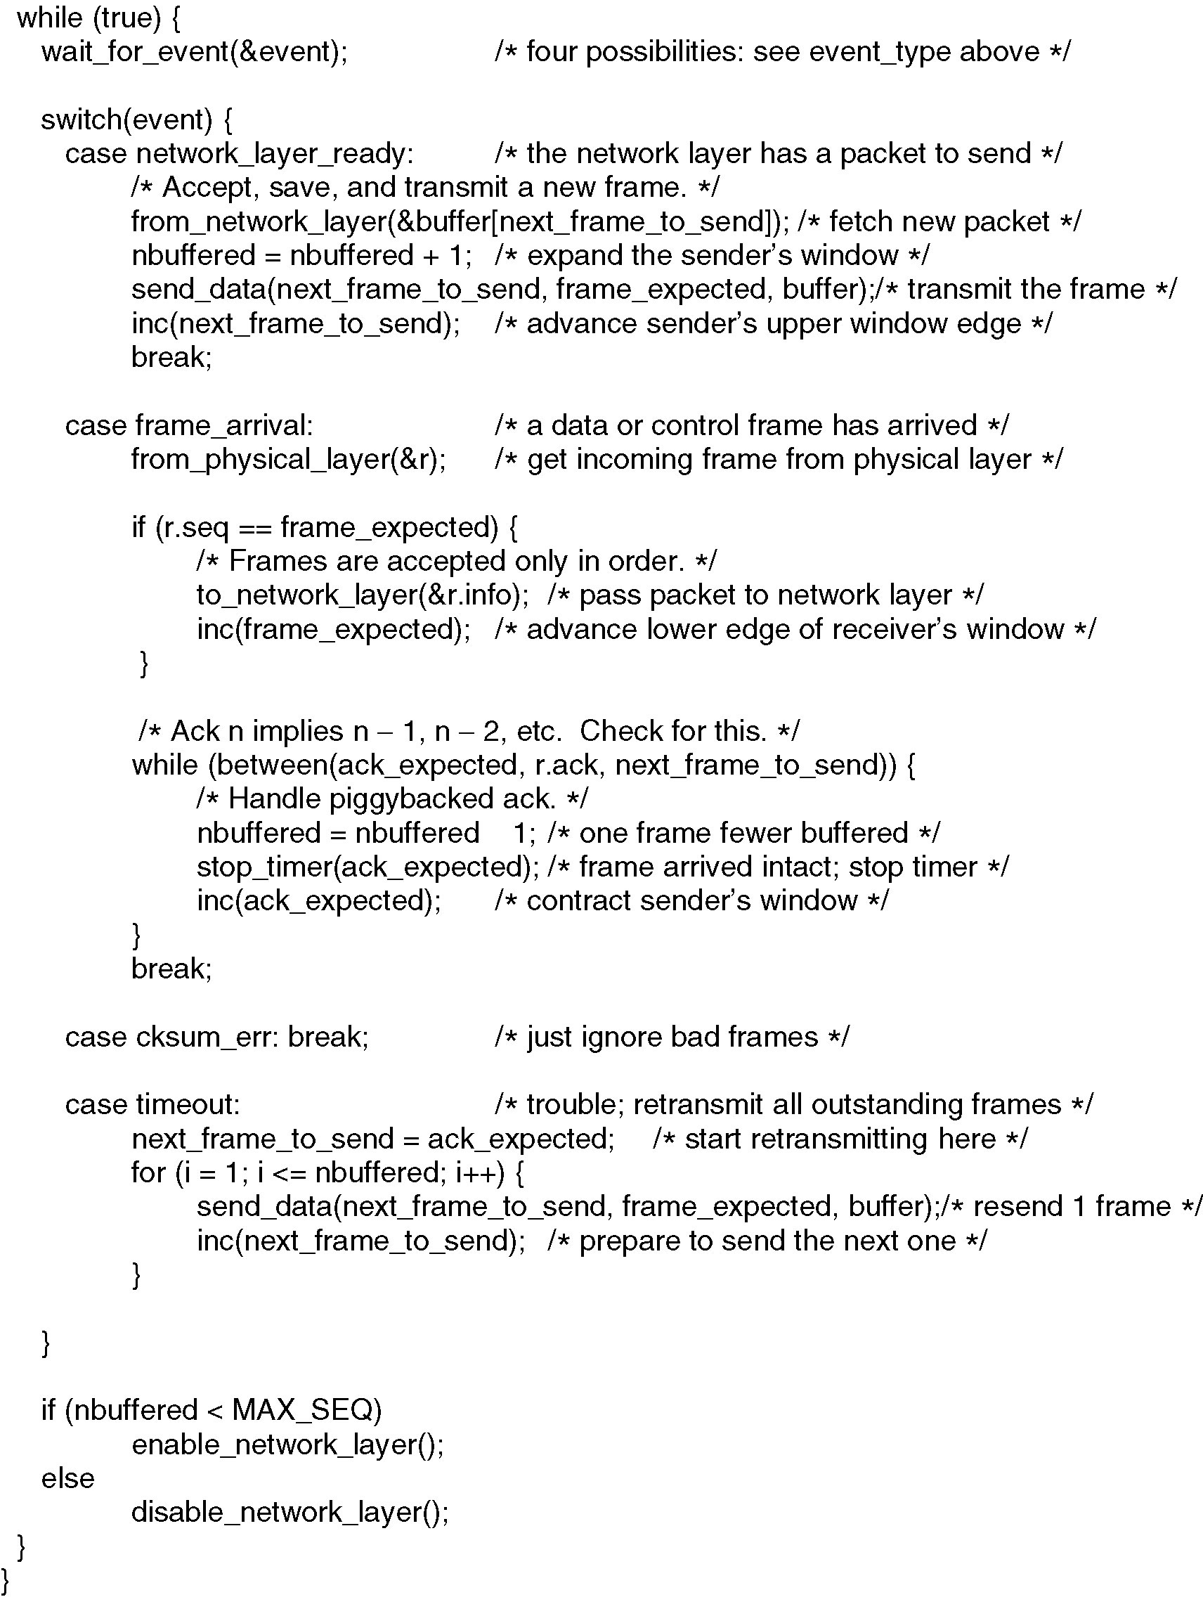
Sliding Window Protocol Using Go Back N
Continued →

Slide 13
Sliding Window Protocol Using Go Back N

Slide 14
Selective Repeat Example
Effect on an error when receiver’s window size is large

Slide 15
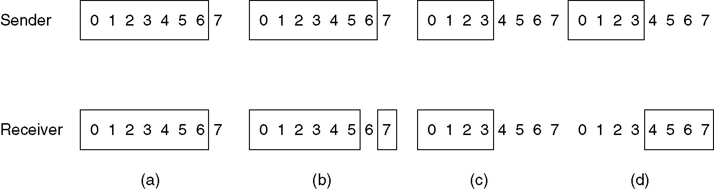
Overlapping Window Problem with Selective Repeat
(a) Initial situation with a window size seven
(b) After seven frames sent and received, but not acknowledged
(c) Initial situation with a window size of four
(d) After four frames sent and received, but not acknowledged

